Slide 1
INDIGENOUS FARMING SYSTEMS AND SUSTAINABLE ENVIRONMENTAL USE
GROUP 18

Slide 2

GROUP MEMBERS
Adjei Yvonne Afua Sika – 4435218
Tawiah Naki Elizabeth – 9219819
Teye Grace – 9219919
Djietror Ahumah Abigail – 9206719
Agbottah Euodias Patand – 9197019
Nyantakyi Daniel Sarfo – 9213819
Agyeman Kyei Maxwell – 9197019
Fynn Clifford Enoch – 9208119
Kesse-Baah Enoch – 9210619

Slide 3

CONTENT
Farming systems
Indigenous farming systems
Advantages & disadvantages
Some practices
Sustainable environmental use

Slide 4



FARMING SYSTEMS
Farming systems refer to the different methods and practices that farmers use to produce crops and raise livestock.
  Traditional farming practices
  Industrial farming practices, etc.

Slide 5
INDIGENOUS FARMING SYSTEM
They are practiced by indigenous people
They have been developed over generations within a specific geographical area and are adapted to local environments.
They are based on traditional knowledge and practices.

Slide 6

ADVANTAGES
Biodiversity conservation
Climate resilience
Food security
Adaptability

Slide 7

DISADVANTAGES
Labor-intensive
Limited yields
Lack of knowledge

Slide 8
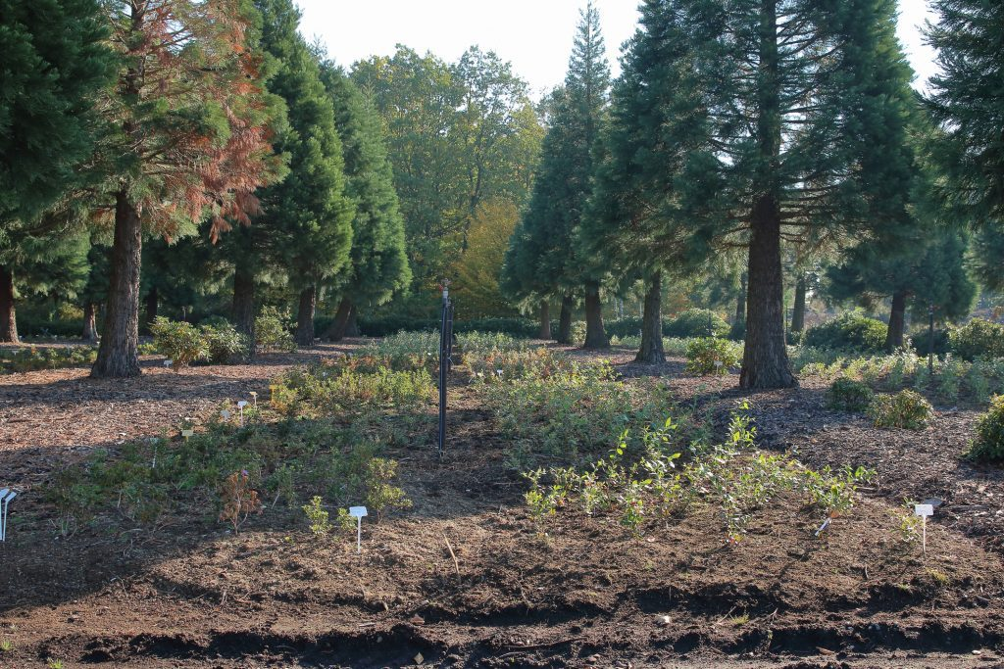
SOME INDIGENOUS FARMING PRACTICES
Agroforestry
Companion planting
Fallowing
Fig 1.0 Agroforestry

Slide 9
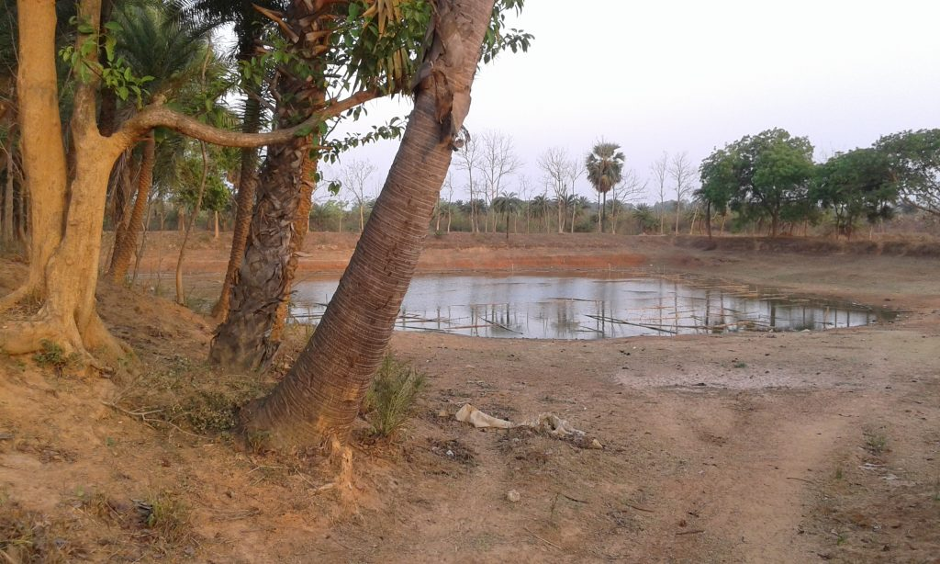
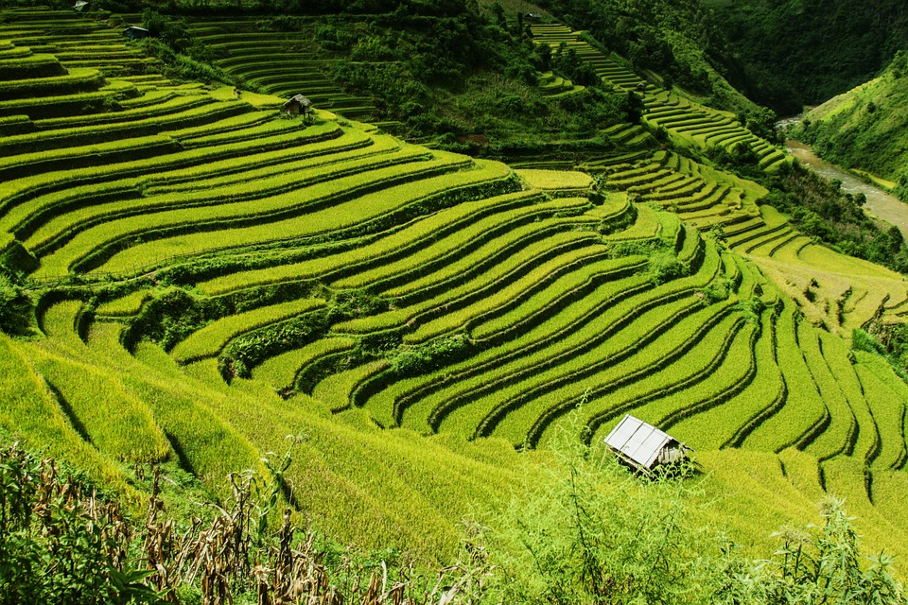
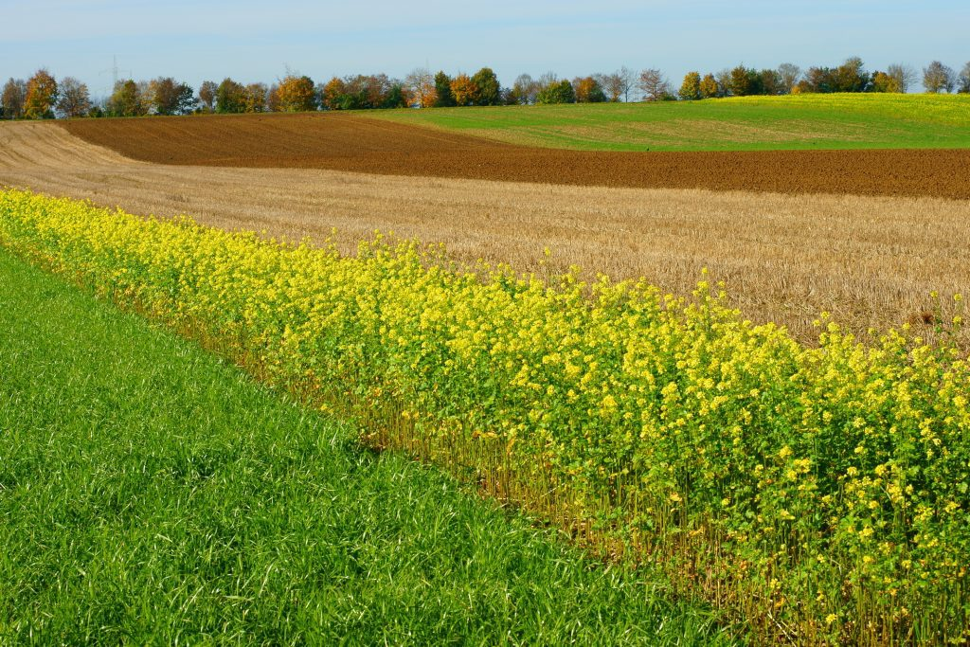
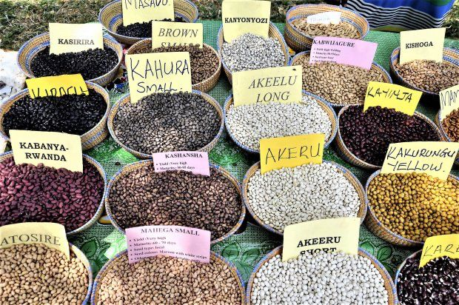
SOME INDIGENOUS FARMING PRACTICES
Fig 3.0 Water harvesting
Fig 5.0 Terracing
Fig 4.0 Crop rotation
Fig 2.0 Seed saving

Slide 10

ENVIRONMENTAL SUSTAINABILITY
Ability to maintain an ecological balance in our planet’s natural environment and conserve natural resources to support the wellbeing of current and future generations.
Indigenous farming systems have long been recognized for their sustainable environmental use.
They prioritize the preservation of ecosystems and the sustainable use of natural resources.

Slide 11
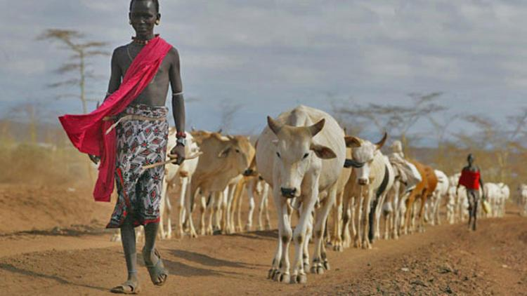
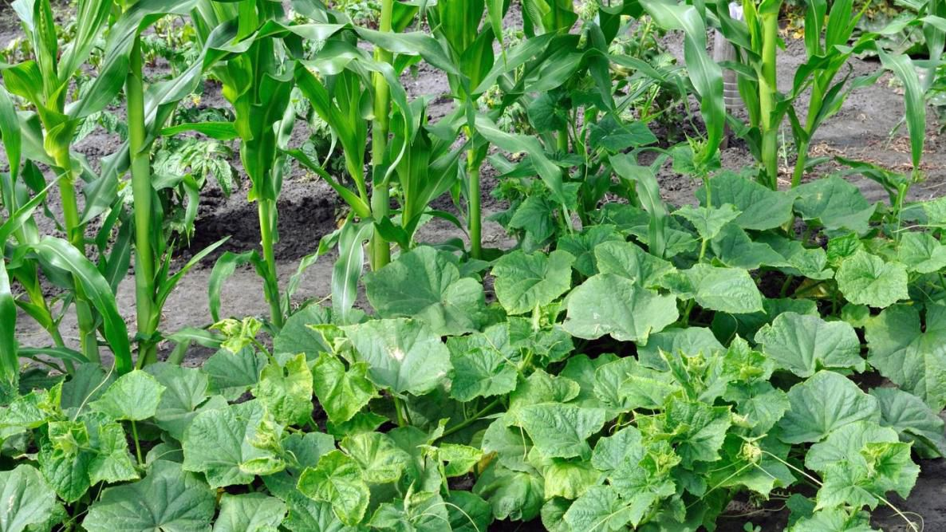
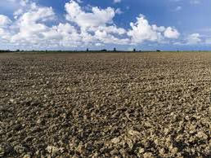
ENVIRONMENTAL SUSTAINABILITY
OF INDIGENOUS FARMING PRACTICES
    Dung from pastoral farming as fertilizer
Agroforestry as a land use management system
Crop rotation combats the impacts of monoculture
Fallowing as a sustainable soil management system
Companion planting

Slide 12
CONCLUSION
The value of indigenous agricultural knowledge cannot be overstated.
Incorporating indigenous farming techniques into modern large scale food systems will make them more sustainable, environmentally friendly, and resilient to issues that can create food security.

Slide 13


REFERENCES
  https://populationeducation.org/four-indigenous-farming-practices-for-a-sustainable-future-today
https://www.researchgate.net/publication/339906139_Indigenous_Agricultural_Practices_A_Supreme_Key_to_Maintaining_Biodiversity
Image credits: Agroforestry (ID 132261092 © Insos Kampung | Dreamstime.com); Crop rotation (ID 53238041 © Martingraf | Dreamstime.com); Companion planting (ID 190386376 © Joycegraceweb | Dreamstime.com); Water harvesting (ID 190509963 © Sourav Mukherjee | Dreamstime.com)

Slide 14

GROUP !8
THANK YOU

